Slide 1
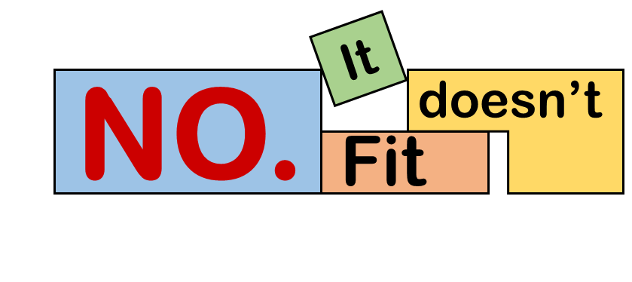
CS442 Term Project
No. It Doesn’t Fit
Team 3 / Inyong Koo, Haram Kwon, Anuar Talipov

Slide 2
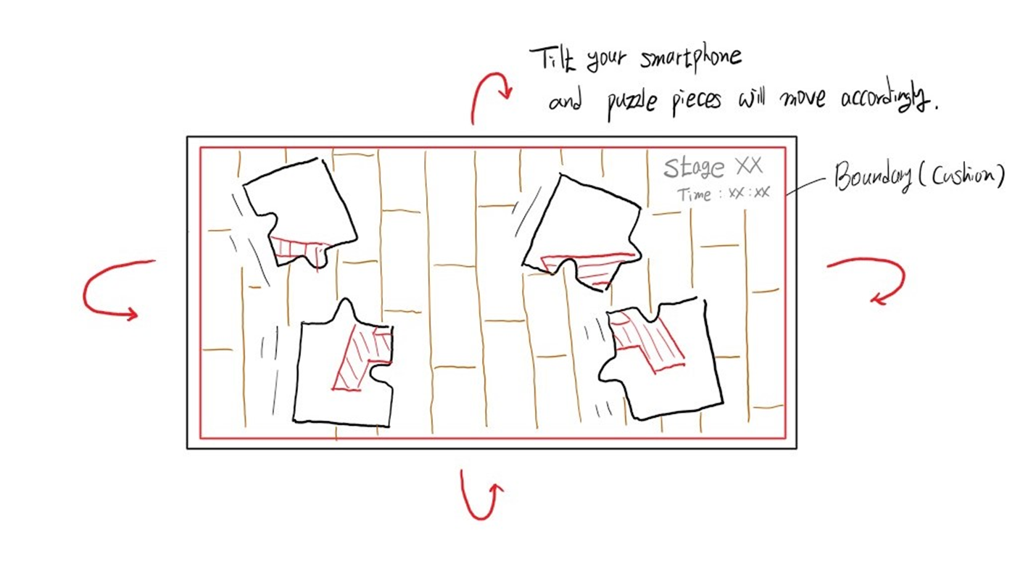

No. It Doesn’t Fit
Started from Hajun’s idea,
We brought our game into the real world.
Solvable
Challenging
Match Purpose
Entertaining

Slide 3
Features
Solvable
Match Purpose
Realistic physics (No rotation)
Adjustable sensitivity
Elaborate level designs
Texture mapping
Sensor usage / vibration
Challenging
Entertaining
Sensor based control
8 different levels
Different music for levels
SFX for collision

Slide 4
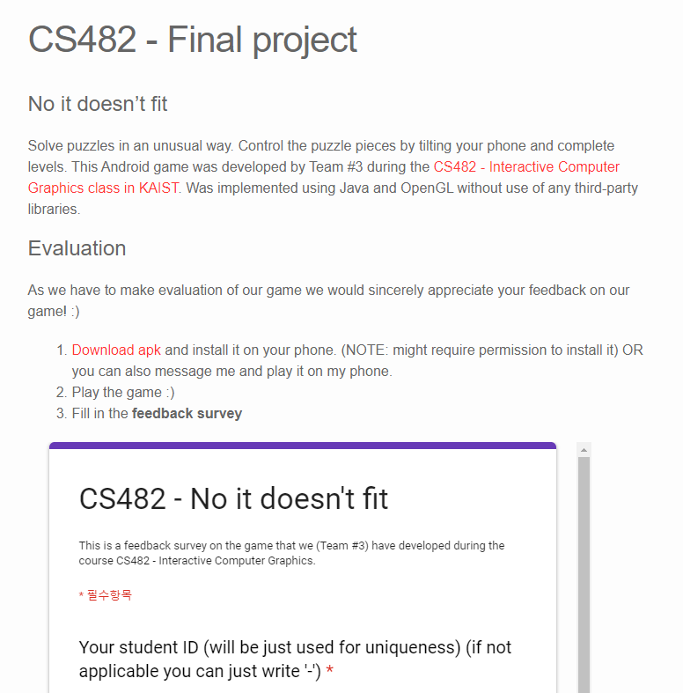
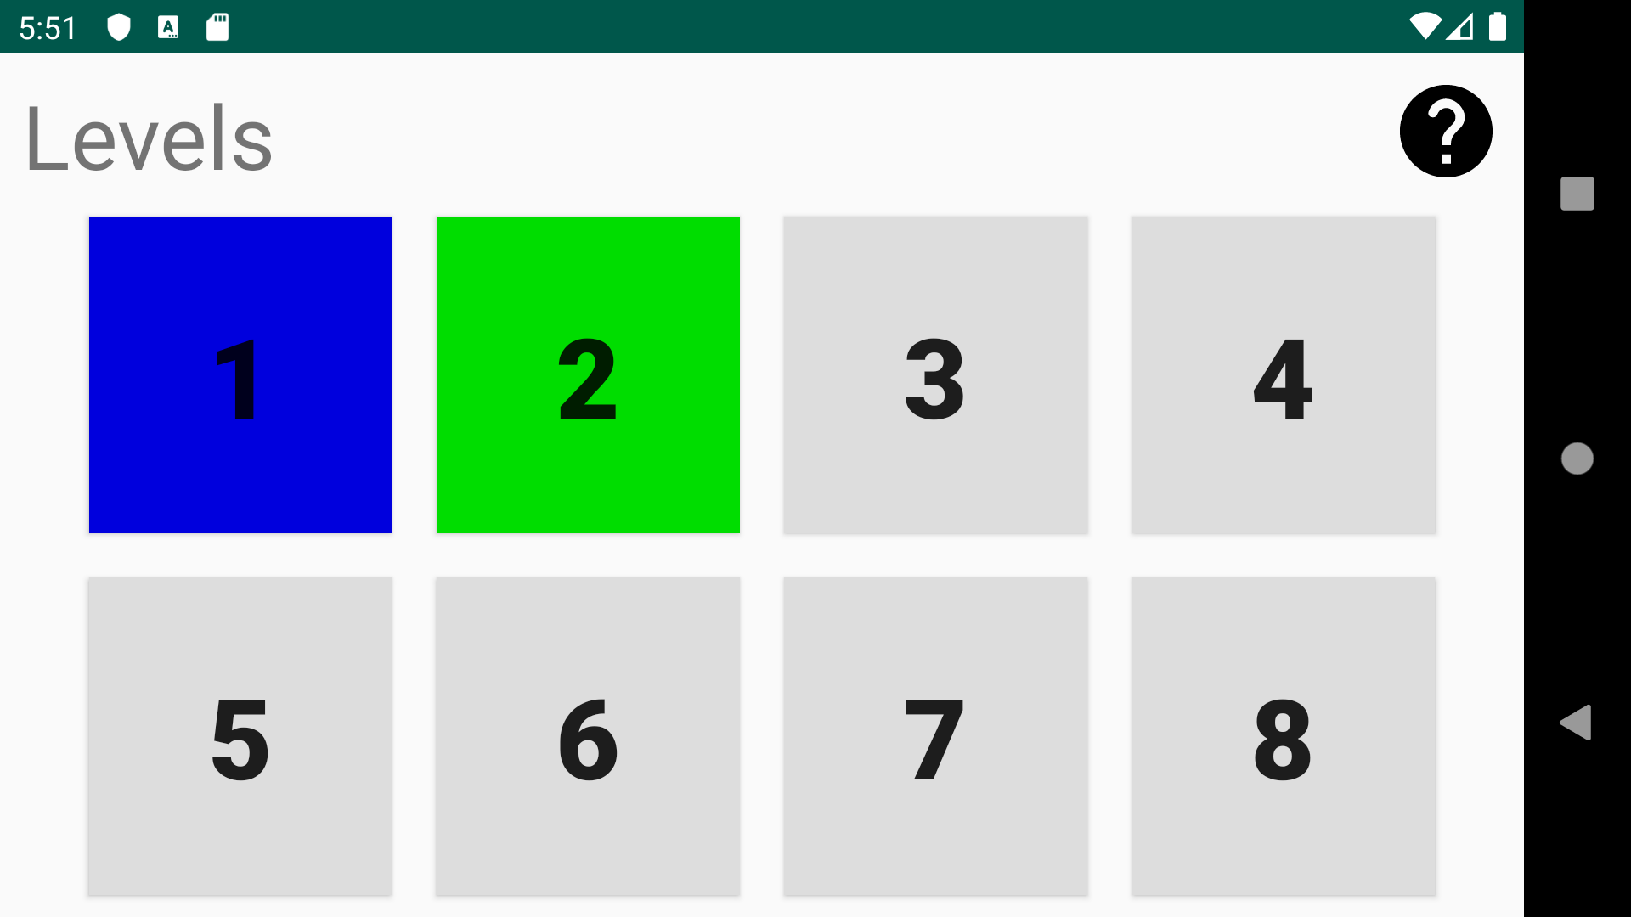
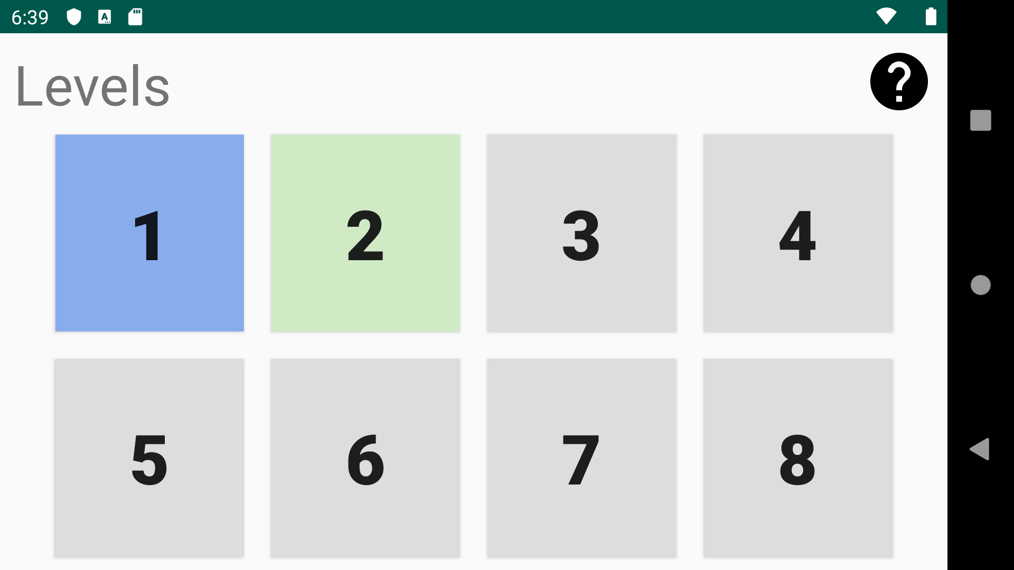
Feedbacks
We made a webpage to distribute app and get feedback.
We took some advices ;)
Go to link below by yourself!
https://anuartb.github.io/cs482-project/
We’ll address the feedbacks later.

Slide 5
Implementation Details
1. We select a level from a menu. UI
2. When a game activity starts, it loads objects. Game Initiator
3. We get sensor data to move puzzle pieces. Game Controller
4. Collision with walls and other pieces will be handled. Physics Engine I
5. We determine if the stage is completed. Physics Engine II
6. Of course, the pieces will be distinguishable. Texture Mapping
7. We also added background music and some effects. Special Effects

Slide 6
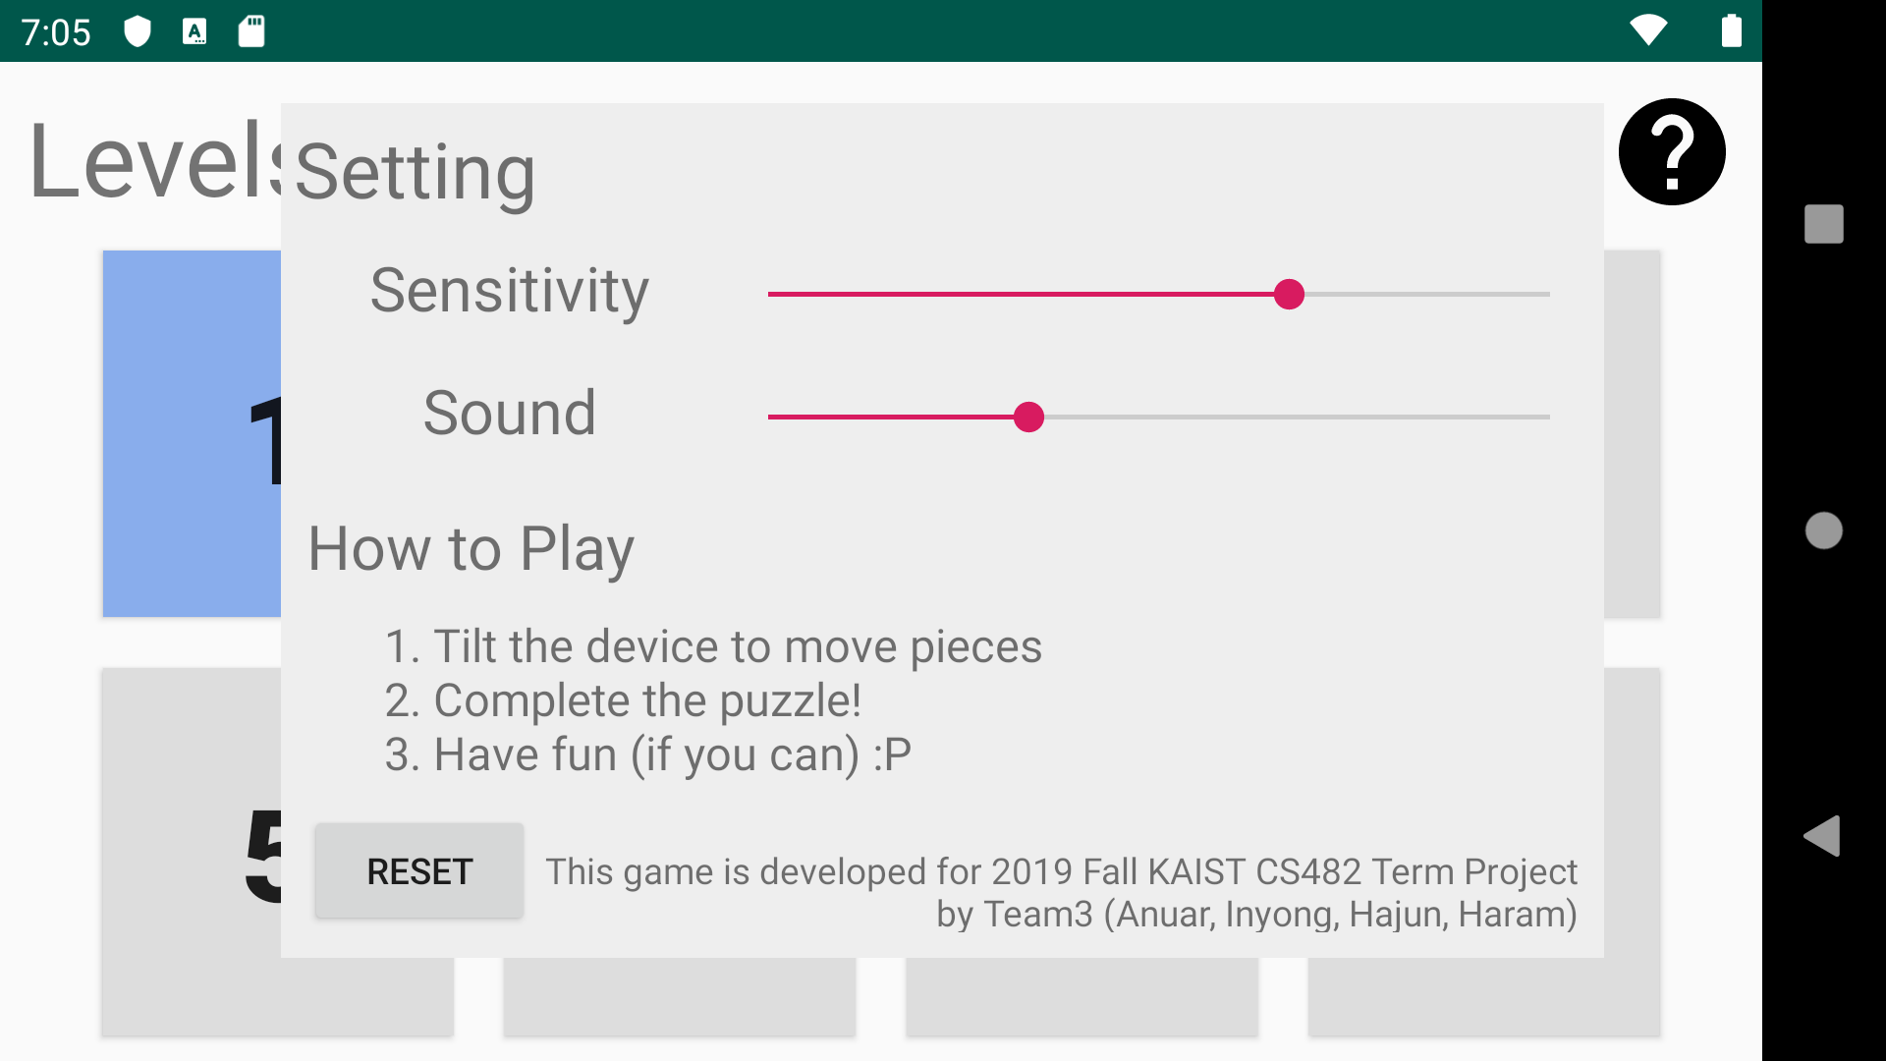
User Interface
Current Level
Solved Level
Level screen
Help screen

Slide 7
Matching Algorithm
If the difference between boundaries is less than some threshold value, then objects are considered as “matched”. Each piece is checked this condition each game loop iteration.
Object
Object
threshold
boundary difference

Slide 8
Matching Algorithm
“Object keeps track of objects that should be in the final puzzle.”
It means that it keeps object IDs of objects that should be on its right, left, bottom and top.
top_id
Object
left_id
right_id
bottom_id

Slide 9

Feedbacks statistics
- We’ve got 21 user test feedbacks!
Average from data in discrete range (1-5).
How enjoyable was the gameplay 4.38
How difficult were the earlier levels (lvl 1-4) 2.45
How difficult were the later levels (lvl 5-8): 4.00
How intuitive was the gameplay: 4.48
If the game was on the Play Store how many stars you would have given:
4.38
To what extent have you liked the music and sound effects:
4.33

Slide 10
Feedbacks statistics
What testers disliked in our game:
Level 7
Unpredicted movement of pieces
TOO HARD
Screen turning off during the game

Slide 11
Feedbacks statistics
What testers liked in our game:
Music!
Simplicity
Gameplay
Challenge
One of reviews: “The simplicity of the game along with the smart level design made me actually play the game till the last level. I also enjoyed that there was no certain time limit, giving me freedom to concentrate and figure out whatever works the best"

Slide 12
Feedbacks statistics
Personal feedbacks and suggestions:
Interface should be improved!
Responsiveness of the app.
More levels!
Add initial picture
Release it on the App Store!!!

Slide 13
Statistics
What testers liked in our game:
Music!
Simplicity
Gameplay
Challenge
One of reviews: “The simplicity of the game along with the smart level design made me actually play the game till the last level. I also enjoyed that there was no certain time limit, giving me freedom to concentrate and figure out whatever works the best"

Slide 14
No. It Doesn’t Fit
Timetable
Week
5 | 6 | 7 | 8 | 9 | 10 | 11 | 12 | 13 | 14 | 15
Anuar
Haram
Inyong
System design
UI design
Level design
Physics implementation
UI implementation
Level implementation
Sensor Manager
Add levels
Texture Mapping
User servey & Feedback
Optional VFX, SFX
Final
Presentation
Progress #2
Progress #3
Progress #4
Complete game design
Game Prototype (Level 1)
Complete development

